Slide 1
Frontogenesis and Frontolysis ATMS 370: 2025
Why do fronts develop?
What conditions foster frontal development?
How do they weaken?

Slide 2
Definitions
Frontogenesis: strengthening of horizonal temperature gradients
Frontolysis: weakening of horizontal temperature gradients

Slide 3
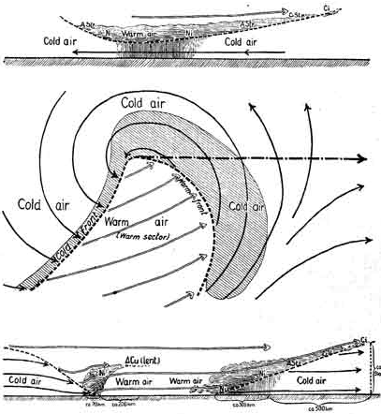
The Norwegian or Bergen School Meteorologists in the early 20th century were the first to describe fronts and their evolution
Bjernkes, 1919

Slide 4
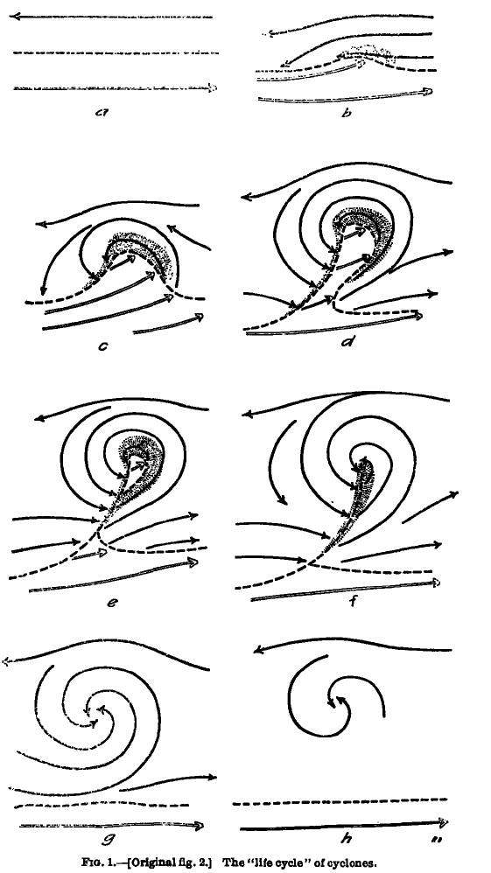
Concept of Evolution of Cyclones Bjerknes and Solberg 1922

Slide 5
The Norwegian Cyclone Model Started with a Strong Polar Front and Had Limited Discussion of How Fronts Formed and Evolved

Slide 6
Why are there fronts?
First attempts were based on the kinematic description of frontogenesis
Kinematics regards the description of motions rather than the forces driving motions
How do wind and temperature fields interact to increase temperature gradients?

Slide 7
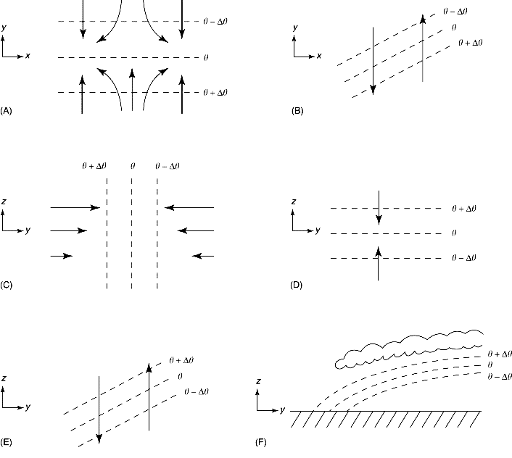
With a pre-existing temperature gradient, certain wind fields can concentrate the temperature gradient, resulting in frontogenesis

Slide 8
Kinematics
Kinematics is the branch of physics that deals with the analysis of the motion of objects without concern for the forces causing the motion.

Slide 9
Kinematics 101: the wind around a point can be linearly decomposed into four key components
Translation
Rotation
Divergence
Deformation

Slide 10
Translation: movement in one direction

Slide 11
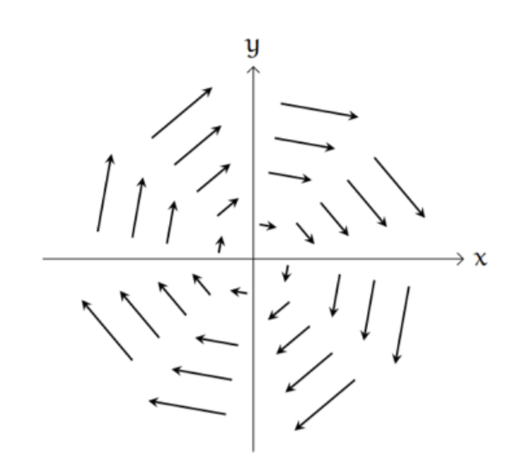
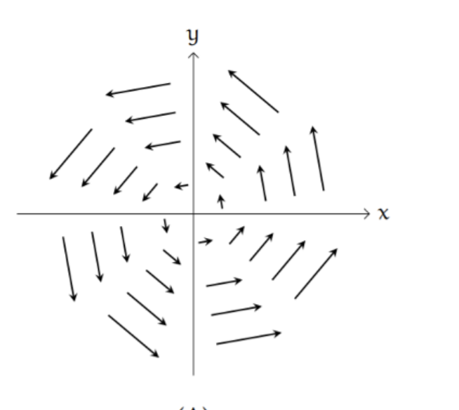
Rotation (cyclonic or anticyclonic)
clockwise
counterclockwise
Anticyclonic (NH)
Cyclonic (NH)
Northern Hemisphere

Slide 12
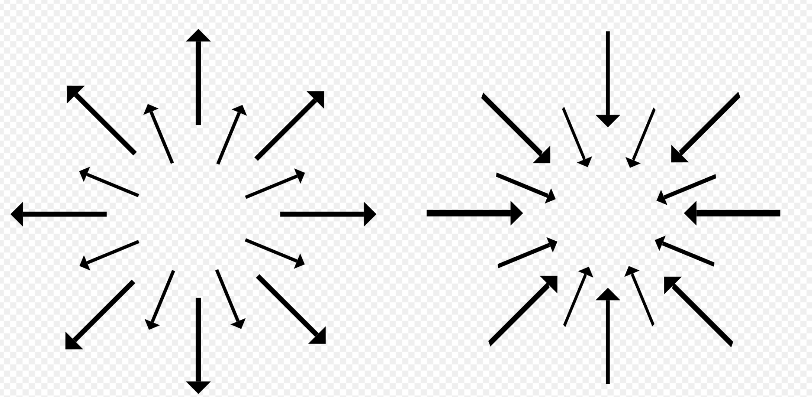
Divergence (or convergence)
Divergence
Convergence

Slide 13
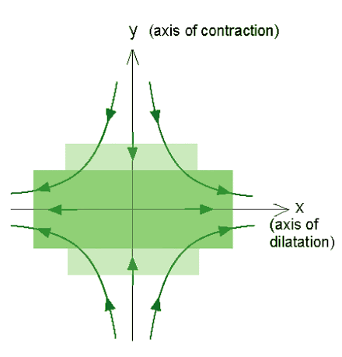
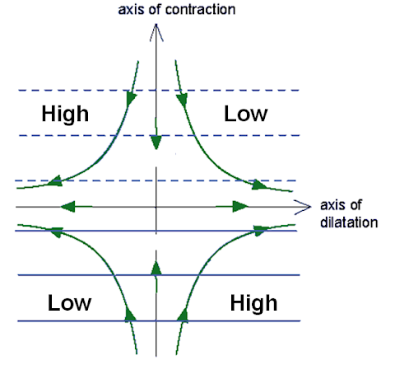
Deformation

Slide 14
The flow around a point can be decomposed into these kinematic components Combining these components can produce many important flow fields

Slide 15
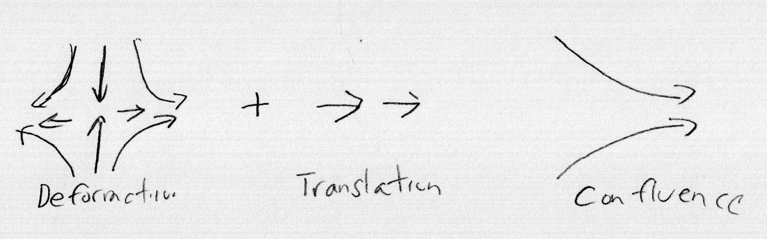
Deformation Plus Translation Results in Confluence

Slide 16
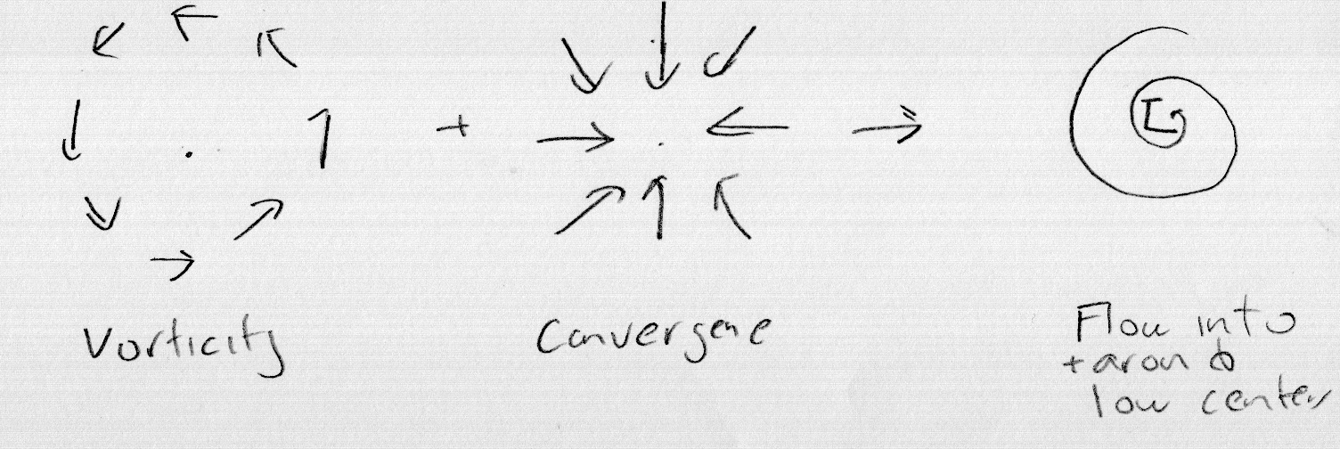
Vorticity Plus Convergence
Rotation
Convergence

Slide 17
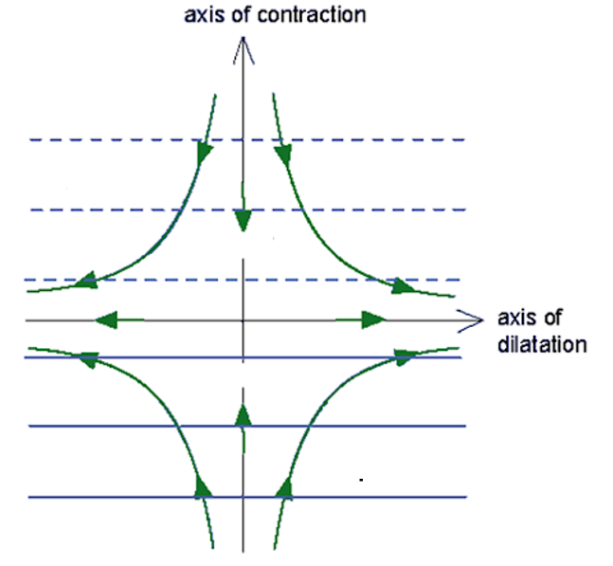
Bergeron (1928) was the first to show that fronts could form/strengthen when deformation acts on a preexisting temperature gradient.
T-ΔT
T
T+ΔT
T+2ΔT
T+3ΔT
T+4ΔT

Slide 18
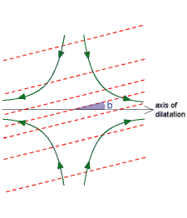
Bergeron also showed that the orientation of isotherms was important: isotherms have to be within 45°of the axis of dilation to get frontogenesis
cooler
Dashed red lies are isotherms
warmer

Slide 19
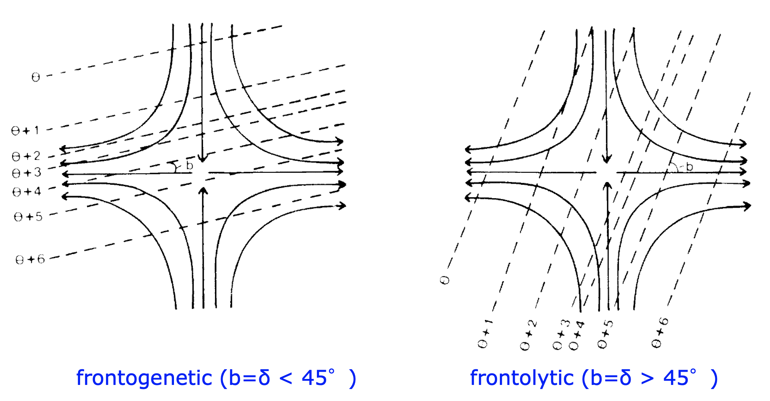
Frontogenetic Versus Frontolytic

Slide 20
Peterssen (1936) showed that convergence in the presence of a temperature gradient can also force frontogenesis
cool
isotherm
warm

Slide 21
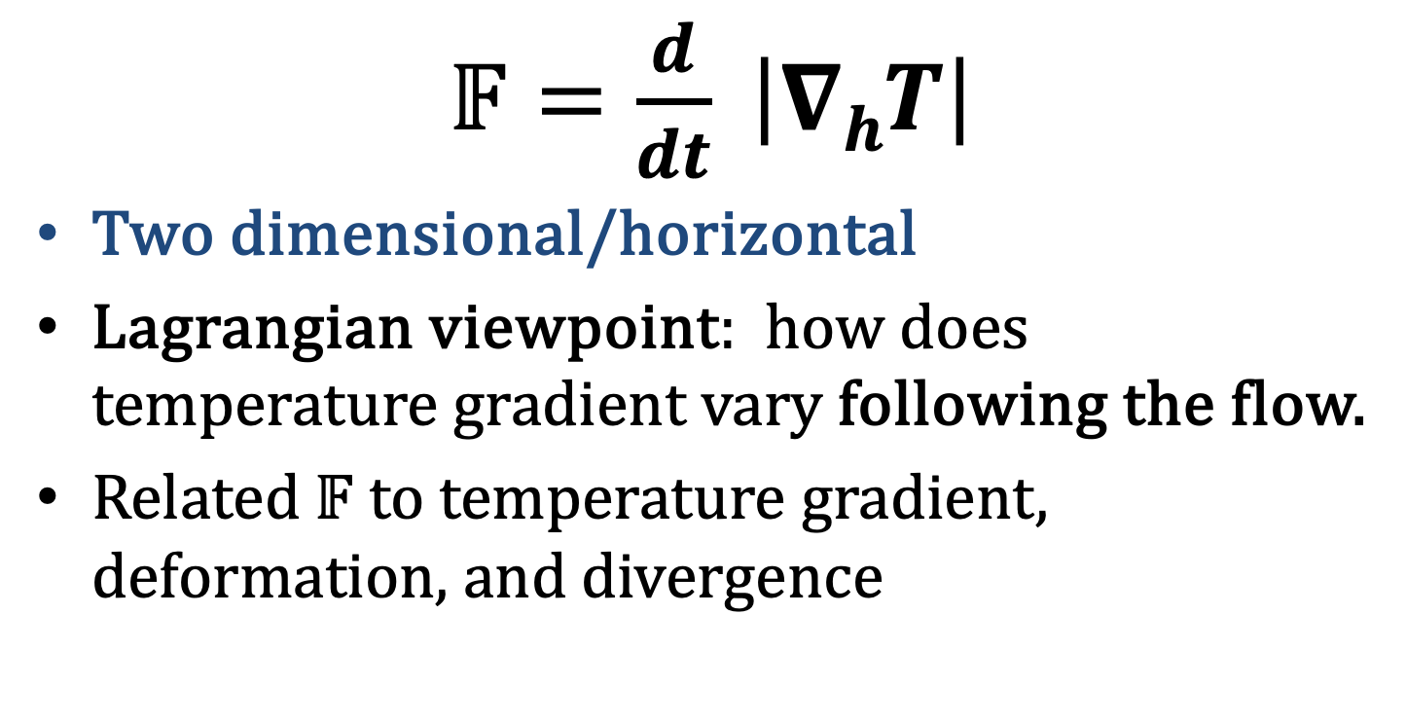
Peterssen Defined a Frontogenesis Function
$𝔽=\frac{d}{dt} \left|∇hT\right|$
Two dimensional/horizontal
Lagrangian viewpoint: how does temperature gradient vary following the flow.
Related $𝔽$ to temperature gradient, deformation, and divergence

Slide 22
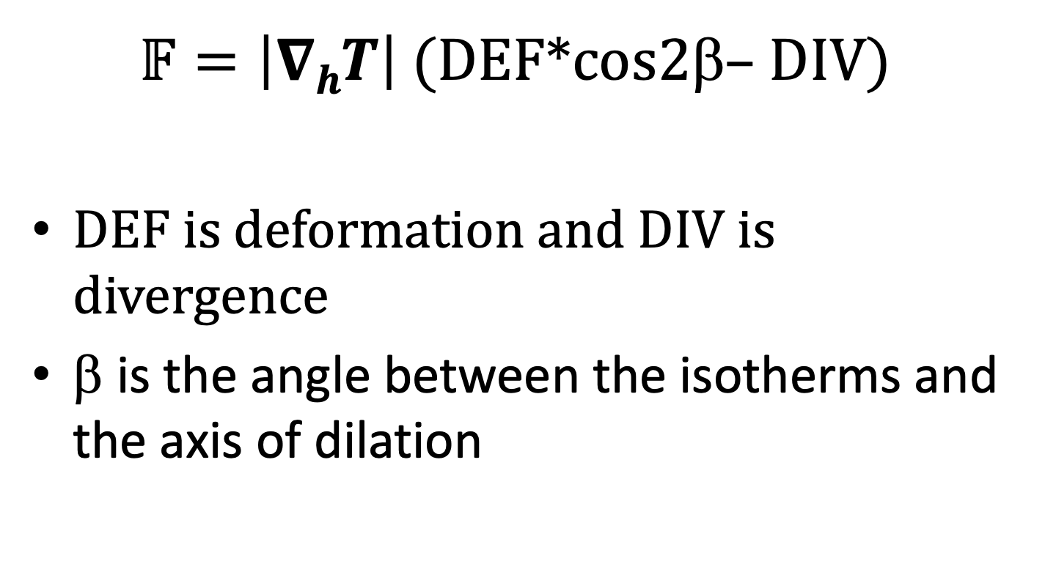
Frontogenesis (2D)
$𝔽=\left|∇hT\right|$ (DEF*cos2β– DIV)
DEF is deformation and DIV is divergence
β is the angle between the isotherms and the axis of dilation

Slide 23
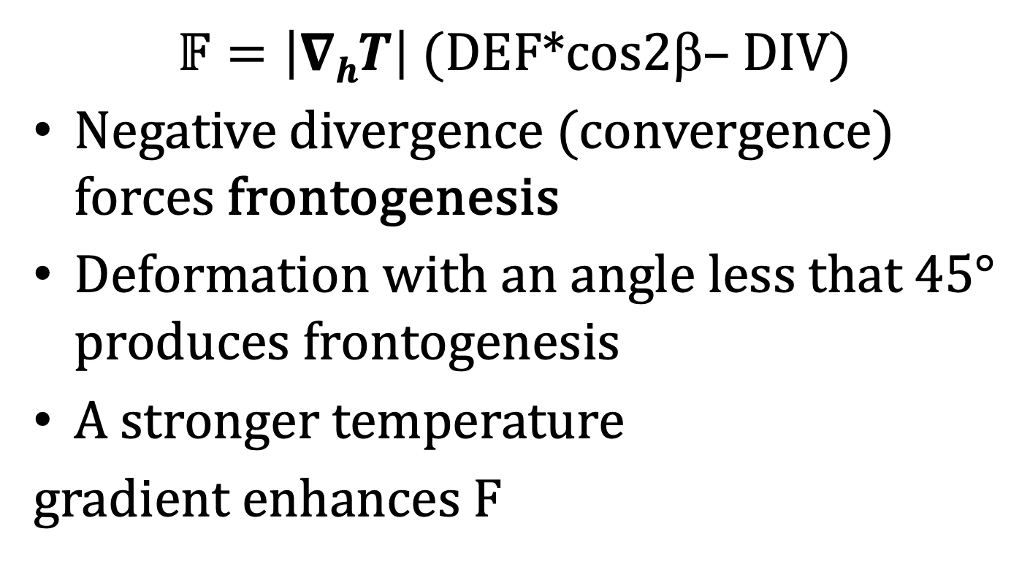
Frontogenesis (2D)
$𝔽=\left|∇hT\right|$ (DEF*cos2β– DIV)
Negative divergence (convergence) forces frontogenesis
Deformation with an angle less that 45° produces frontogenesis
A stronger temperature
gradient enhances F

Slide 24
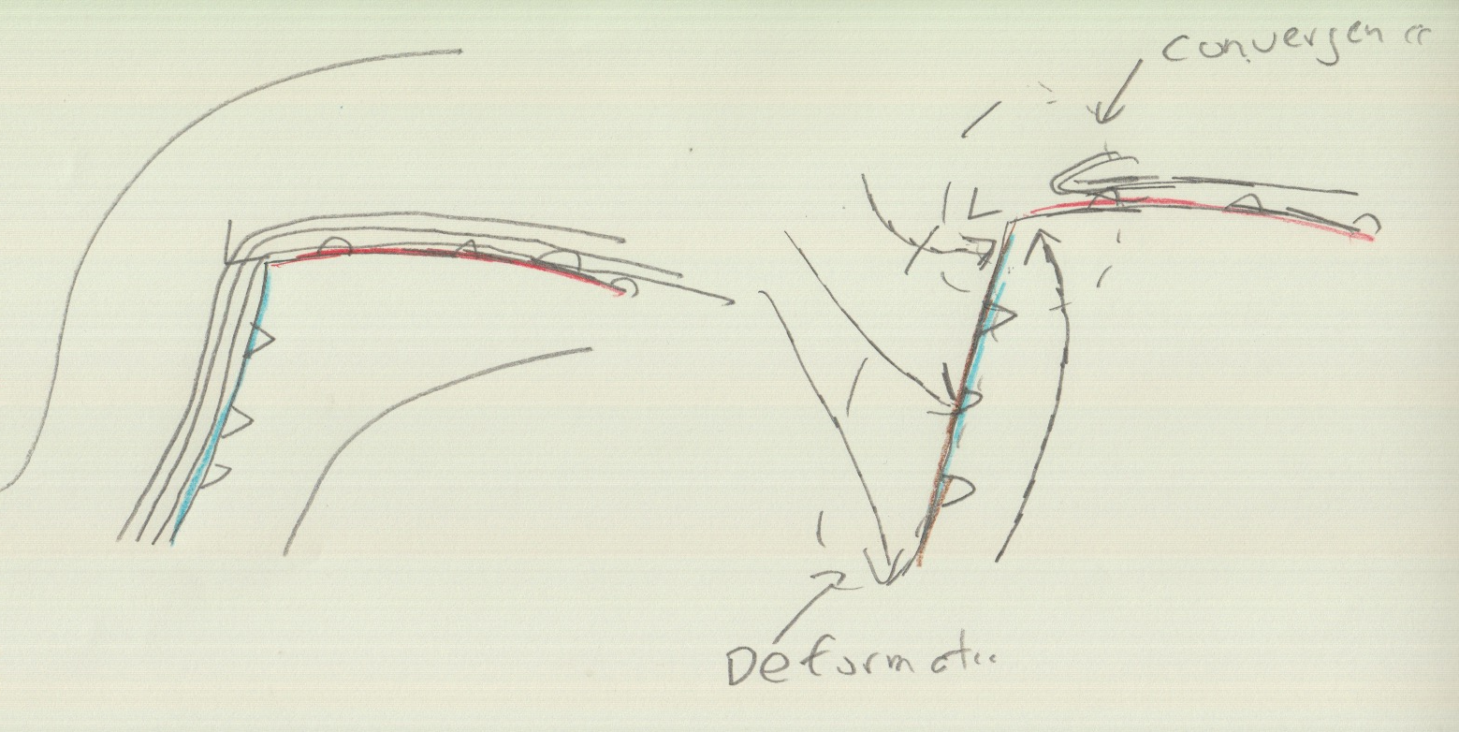
Both convergence and deformation contribute to frontogenesis in a typical midlatitude cyclone
isotherm
colder
warm

Slide 25
Let’s Check Out Real Examples!

Slide 26
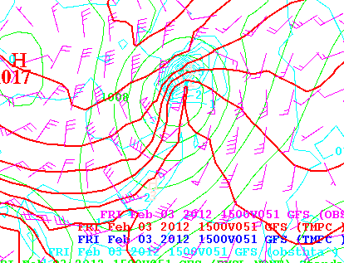
Light Blue is Frontogenesis
Convergence
Frontogenesis
Deformation
Frontogenesis

Slide 27
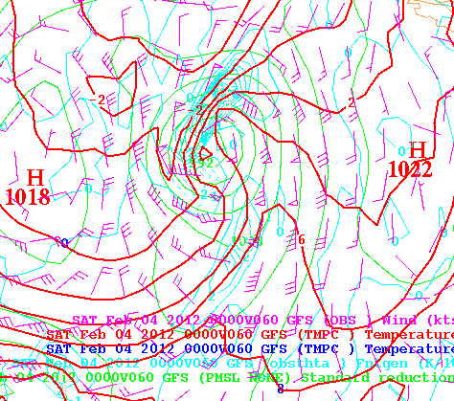

Slide 28
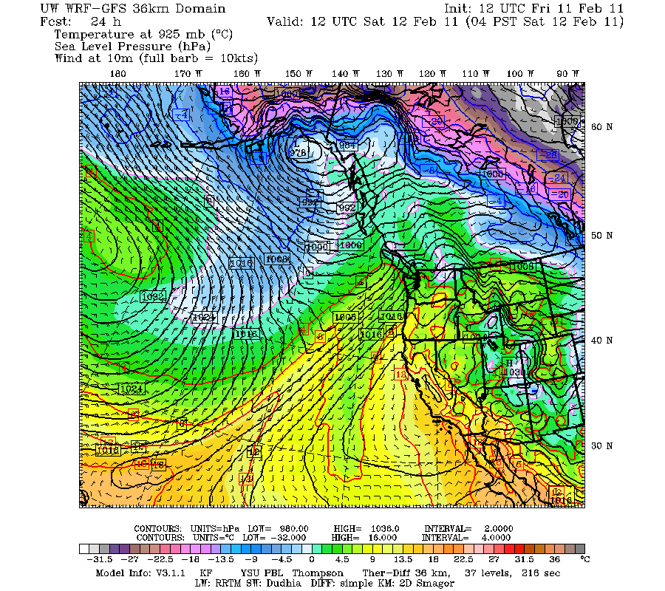
Deformation
In winds with
Around the cold front

Slide 30
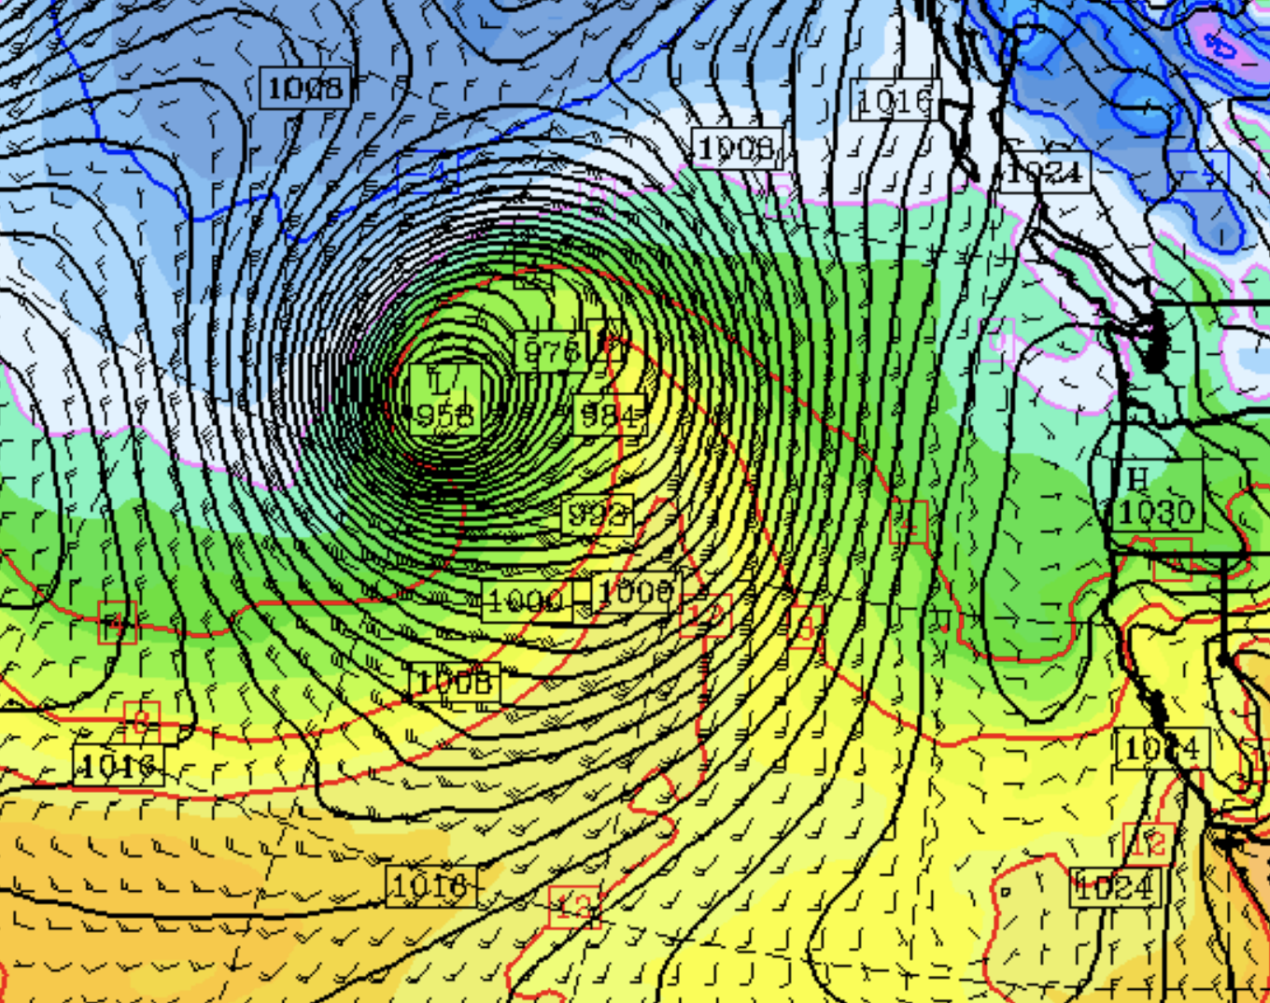

Slide 31
Theoretical Studies in the 1940s and 1950s Showed That Synoptic Scale Deformation and Convergence Was NOT Enough to Rapidly Produce Mesoscale Fronts
The “secret” was learned in the 1950s.
Mesoscale processes are needed for the final and rapid concentration of temperature gradients.

Slide 32
Synoptic Scale Winds Alone Were Not Enough
Cold air
Warm air
Arrows show large-scale synoptically forced winds

Slide 33
Now the secret…..

Slide 34
An Application of Le Chatelier’s Principle
If the equilibrium of a system is disturbed by a change in one or more of the determining factors (as temperature, pressure, or concentration) the system tends to adjust itself to a new equilibrium by counteracting as far as possible the effect of the change
— Le Chatelier's principle, Merriam-Webster Dictionary

Slide 35
Secondary Circulations: Help Tighten Up Front!
Downward motion
Adiabatic warming
Upward motion
Adiabatic cooling
Cold air
Warm air
Secondary circulation fighting the synoptic forcing

Slide 36
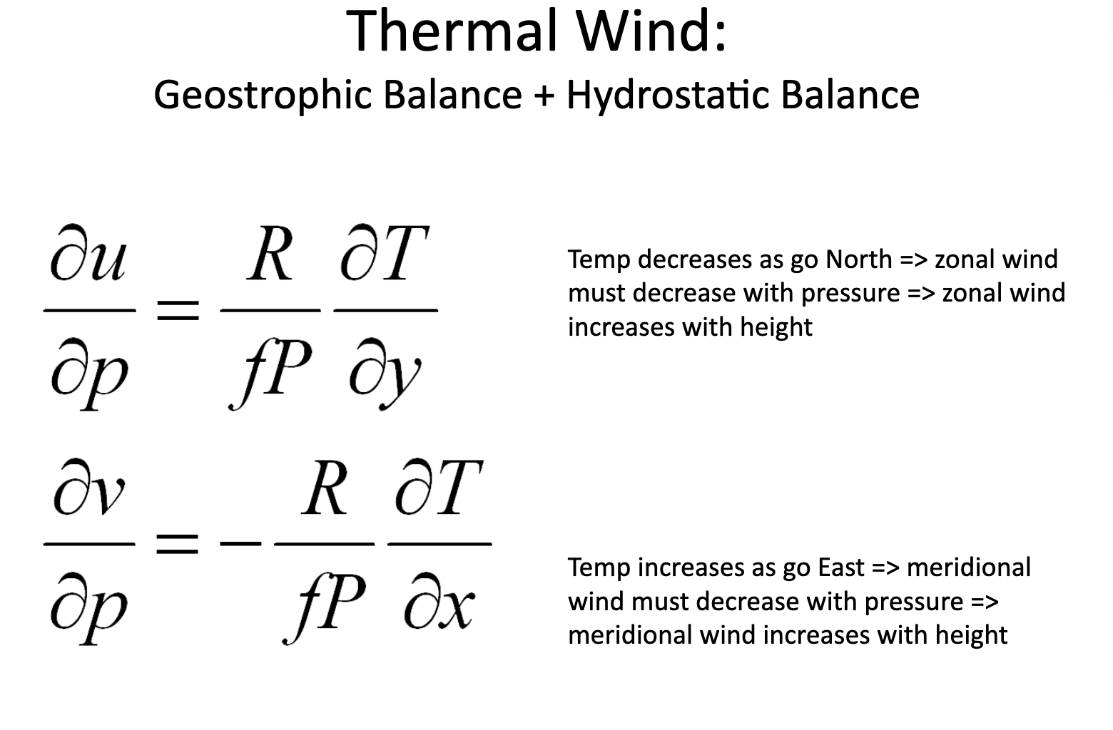

Slide 37
Secondary Circulations Occur to Attempt to Retain Thermal Wind Balance
Cold air
Warm air
Ironically, the secondary circulations enhance the mesoscale temperature gradients associated with the front

Slide 38
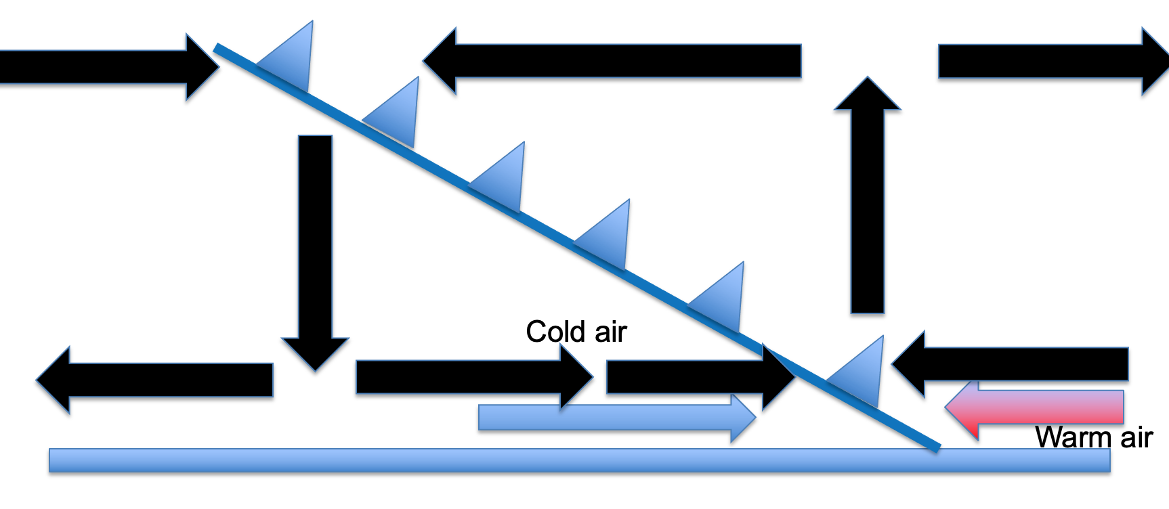
Rapid Collapse of Fronts
With the secondary circulations working, fronts can rapidly intensity.
Major increases in frontal intensity can occur in less than a day.

Slide 39
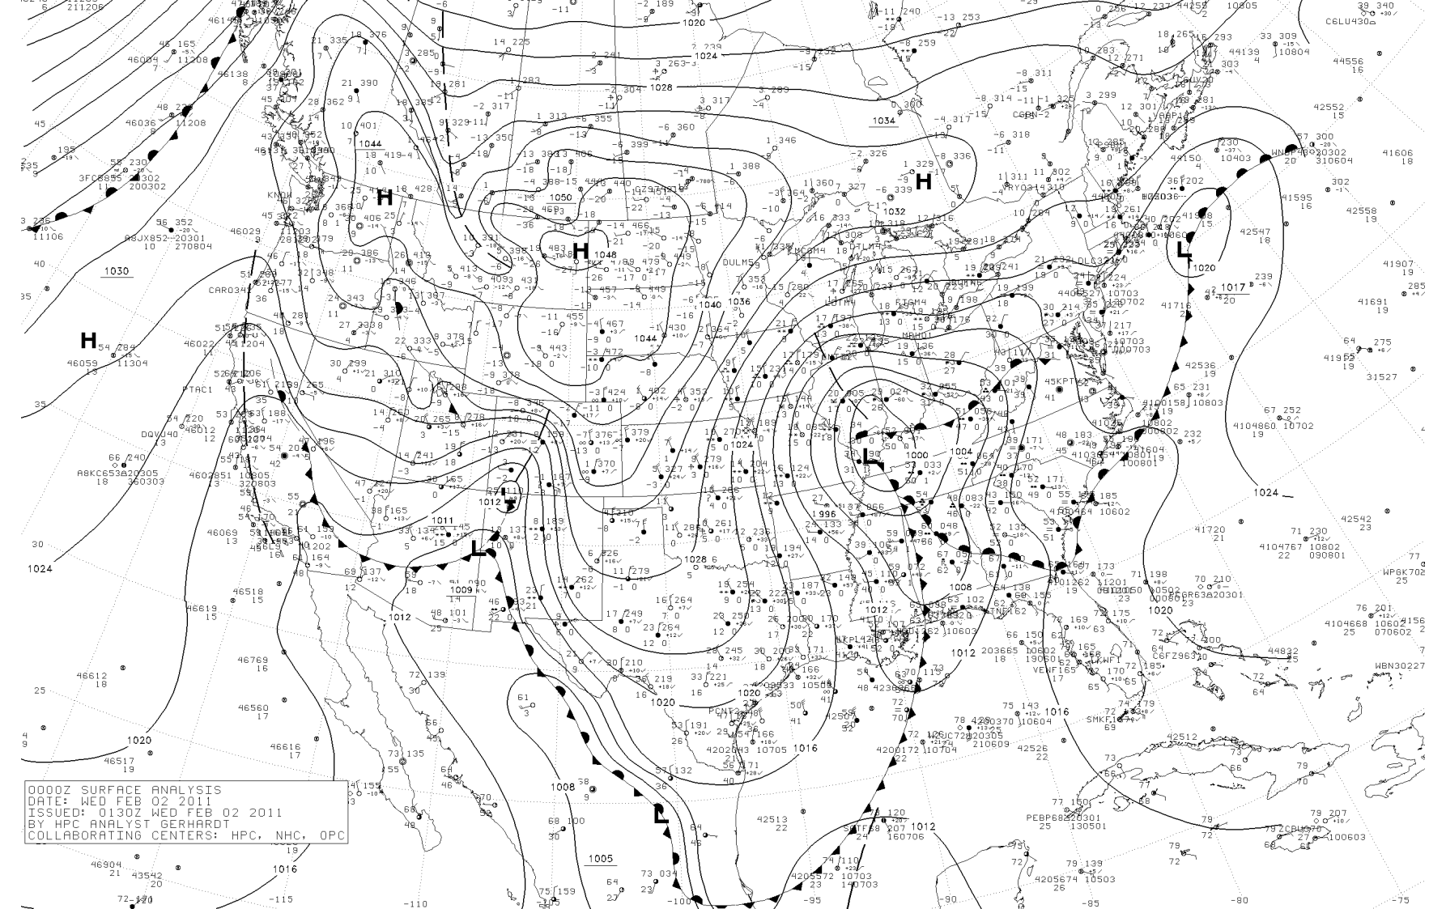
Typically, low-level fronts weaken with height (horizontal temperature gradients lessen with height)

Slide 40
Surface

Slide 41
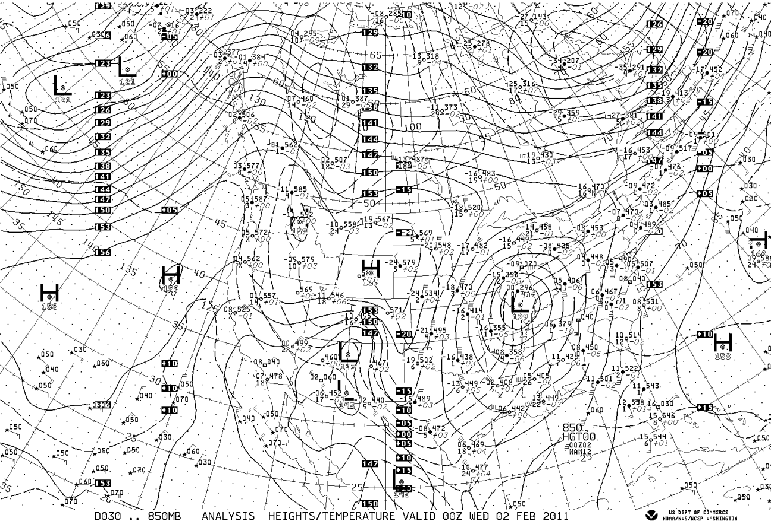
850 hPa

Slide 42
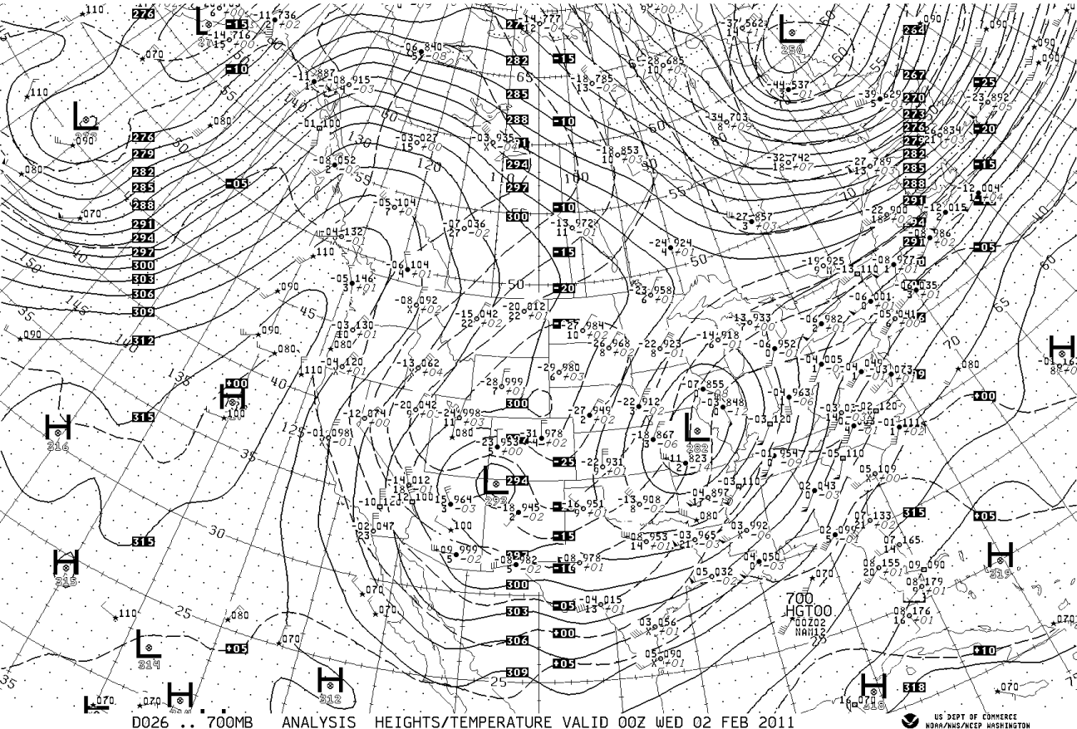
700 hPa

Slide 43
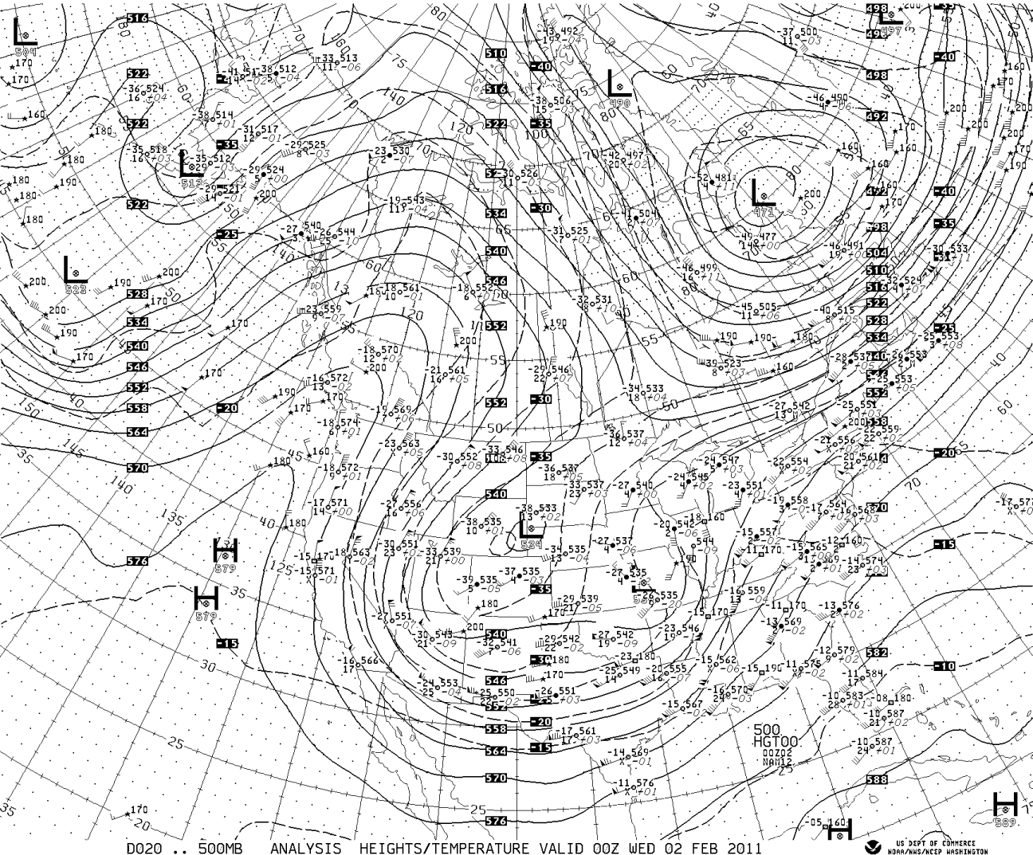
500 hPa

Slide 44
Why do fronts weaken away from the surface? Vertical motions increase aloft!

Slide 45
Vertical motions increase with height and weaken temp. gradient
Adiabatic cooling on warm side
Adiabatic warming
On cold side
Warm air
Cold air
Thus, the effects of vertical motions on temperature increase with height

Slide 46
Vertical motions can also create and maintain fronts in some locations
Near the tropopause, vertical motions can create/strengthen upper-level fronts.
Horizontal variations in vertical motion can produce horizontal temperature gradients through a mechanism called tilting.

Slide 47
Higher Potential Temperature
Adiabatic warming
UP
Adiabatic cooling
Lower Potential Temperature
Vertical Motions Can Create a Temperature Gradient
Called tilting frontogenesis

Slide 48
Higher Potential Temperature
Adiabatic warming
UP
Adiabatic cooling
Lower Potential Temperature
Cooling
Warming

Slide 49
Fronts often develop and strengthen during midlatitude cyclone development
Frontogenesis and cyclogenesis go hand in hand!

Slide 50
Simulations of cyclogenesis/frontogenesis

Slide 51
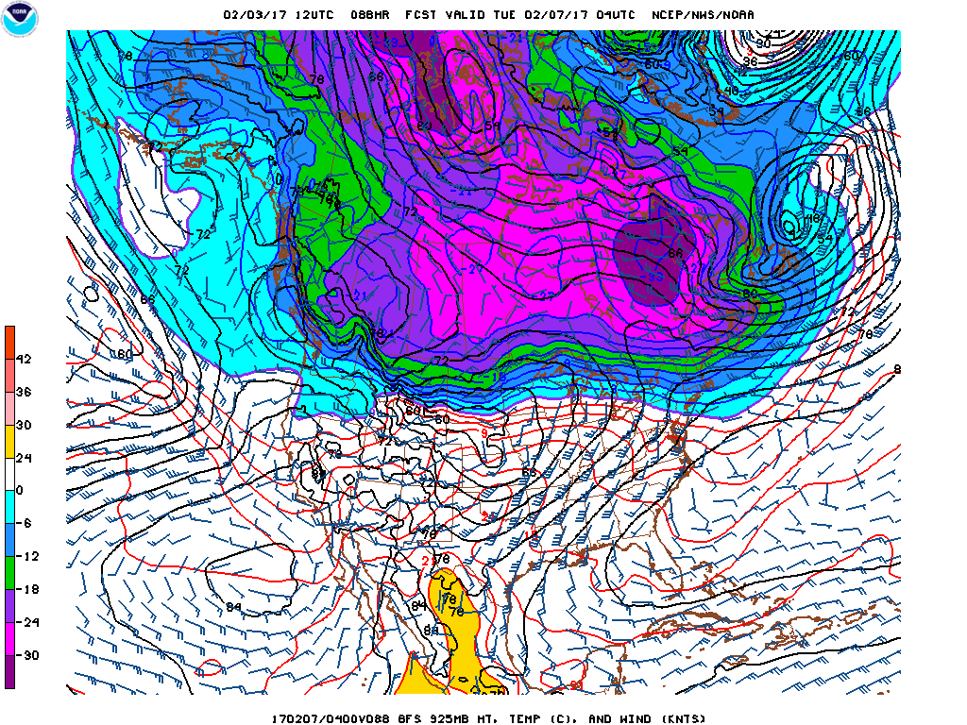

Slide 52
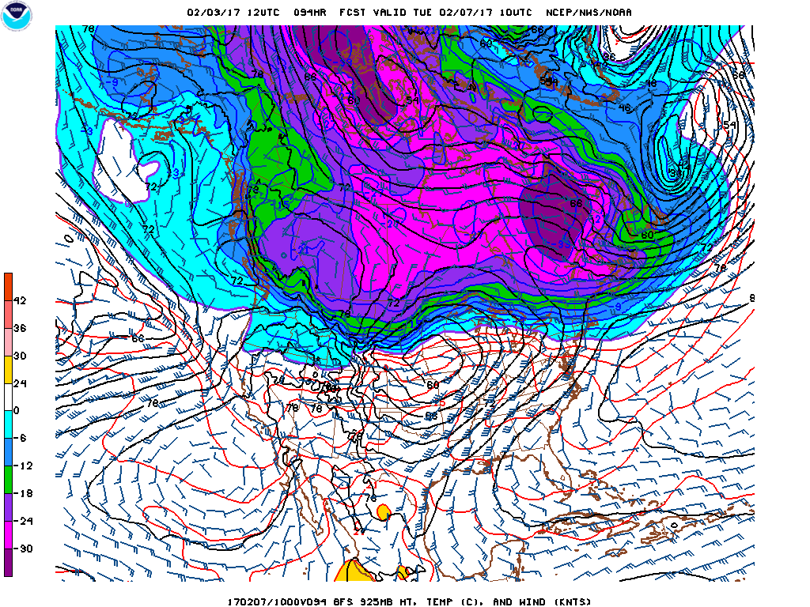

Slide 53
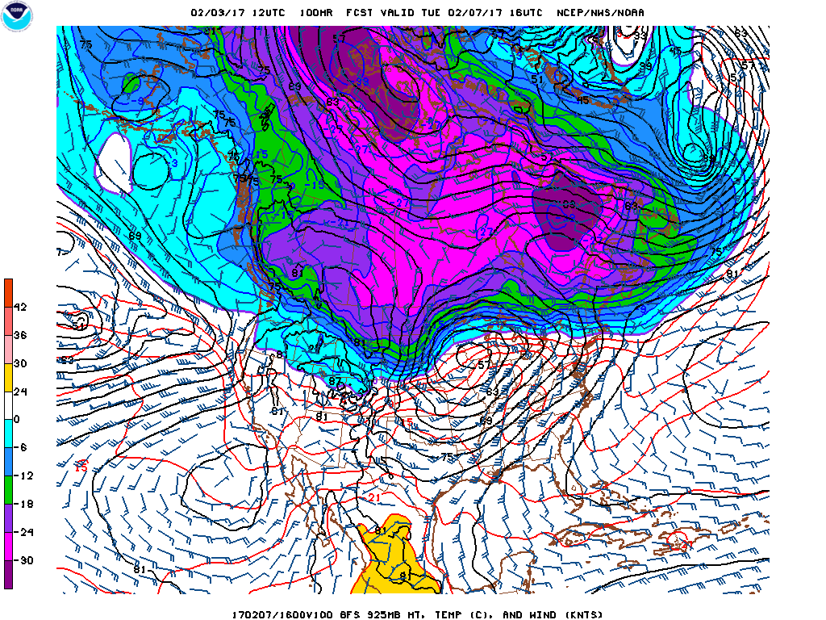

Slide 54
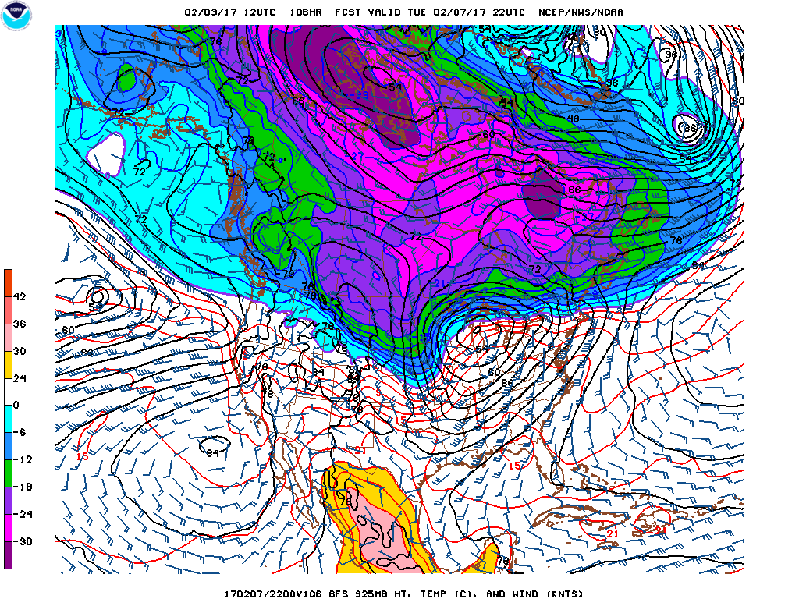

Slide 55
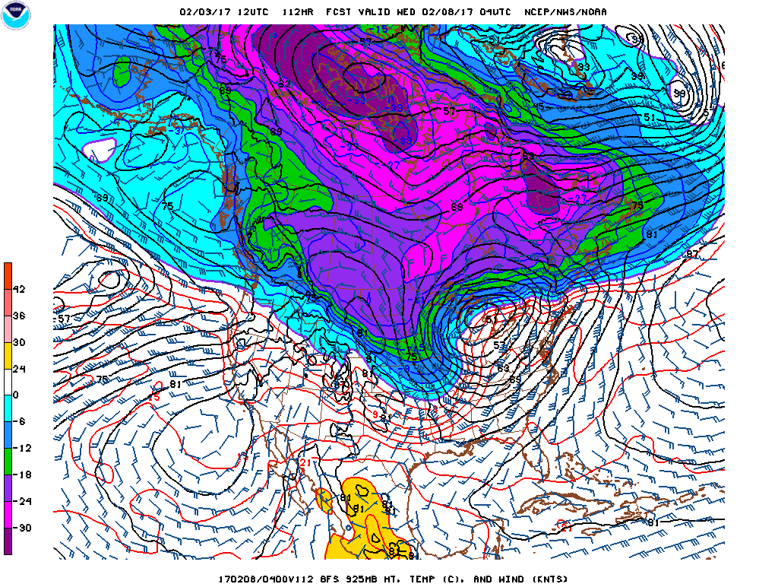

Slide 56
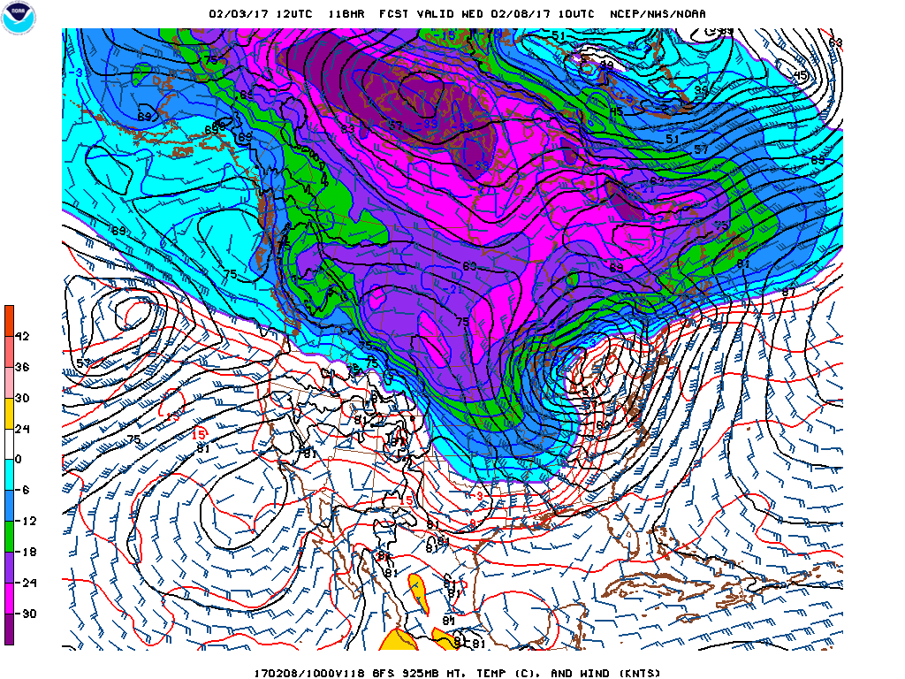

Slide 57
Frontal Width
Typically, most of the temperature drop occurs over 100-200 km.
In very sharp fronts, the majority of the change can occur in 1-10 km
Terrain can help sharpen fronts (e.g., Colorado Front Range near Denver)
Over the oceans. the frontal temperature change can weaken and expand.

Slide 58
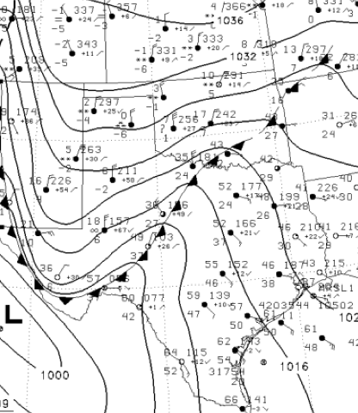
Some Fronts Are Very Sharp Particularly Near the Surface and Terrain

Slide 59
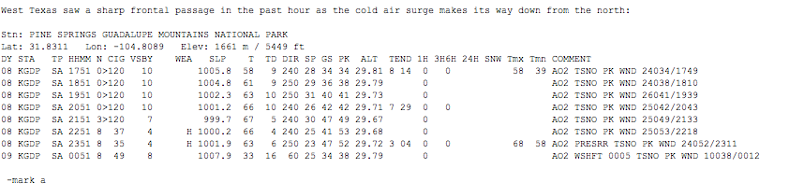

Slide 60
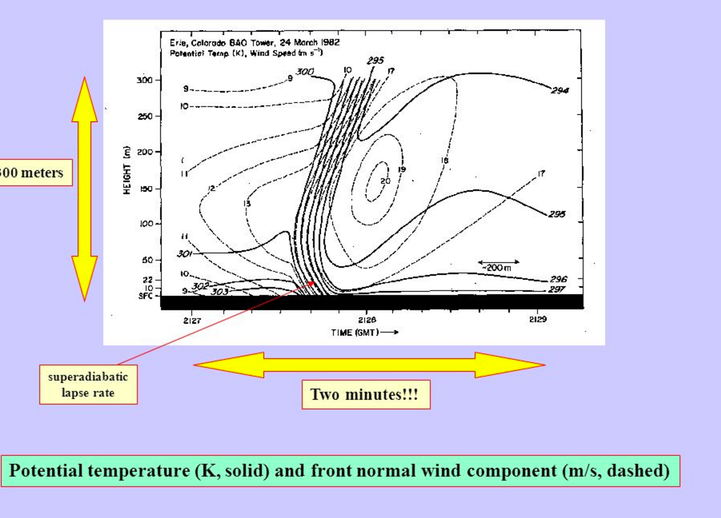
Colorado Event

Slide 61
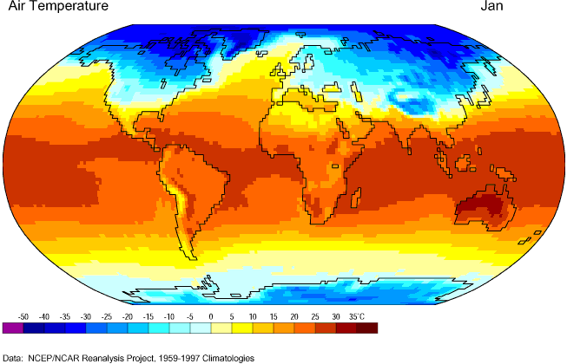
Fronts (and cyclones) tend to develop or are strongest in regions of naturally strong horizontal temperature gradients (e.g., SE US)

Slide 62

This Makes Sense from the Frontogenetical Equation
$𝔽=\left|∇hT\right|$ (DEF*cos2β– DIV)

Slide 63
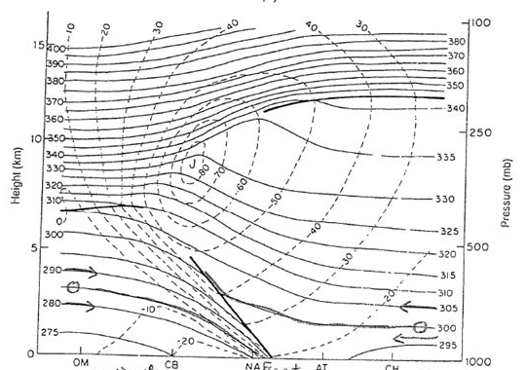
Fronts are strongest near atmosphere “barriers”
Near the ground, where weak vertical motions don’t reduce temperature gradients.
Aloft near the tropopause (upper-level fronts), where distortions of strong vertical potential temperature gradients can produce horizontal temperature gradients.

